Slide 1

RANDOM NUMBERS

Slide 2
RANDOM NUMBERS
Number of five digits can follow the combinations given below (with example):
Five different digits = 12345
Pairs = 22960
Two pairs = 55996
Three of a kind = 52228
Full houses = 77766
Four of a kind = 83333
Five of a kind = 11111

Slide 3
RANDOM NUMBERS
QUESTION - 3
A sequence of 10,000 five digit random numbers has been generated, and an analysis of numbers indicate that there are 3075 numbers having five different digits, 4935 having a pair, 1135 having two pairs, 695 having three of a kind, 105 having full house, 54 having four of a kind and 01 having five of a kind. Use Poker test to determine if these random numbers are independent at α = 0.01
ANSWER
Five different digits = (10/10) * (9/10) * (8/10) * (7/10) * (6/10) * (5!/5!) = 0.3024
Pairs = (10/10) * (1/10) * (9/10) * (8/10) * (7/10) * (5!/(2!3!)) = 0.5040
Two pairs = (10/10) * (1/10) * (1/10) * (9/10) * (8/10) * (5!/(2!2!1!)) * (1/2) = 0.1080
Three of a kind = (10/10) * (1/10) * (1/10) * (9/10) * (8/10) * (5!/(3!2!)) = 0.0720
Full houses = (10/10) * (1/10) * (1/10) * (9/10) * (1/10) * (5!/(3!2!)) = 0.009
Four of a kind = (10/10) * (1/10) * (1/10) * (1/10) * (9/10) * (5!/(4!1!)) = 0.0045
Five of a kind = (10/10) * (1/10) * (1/10) * (1/10) * (1/10) * (5!/(5!0!)) = 0.00001

Slide 4
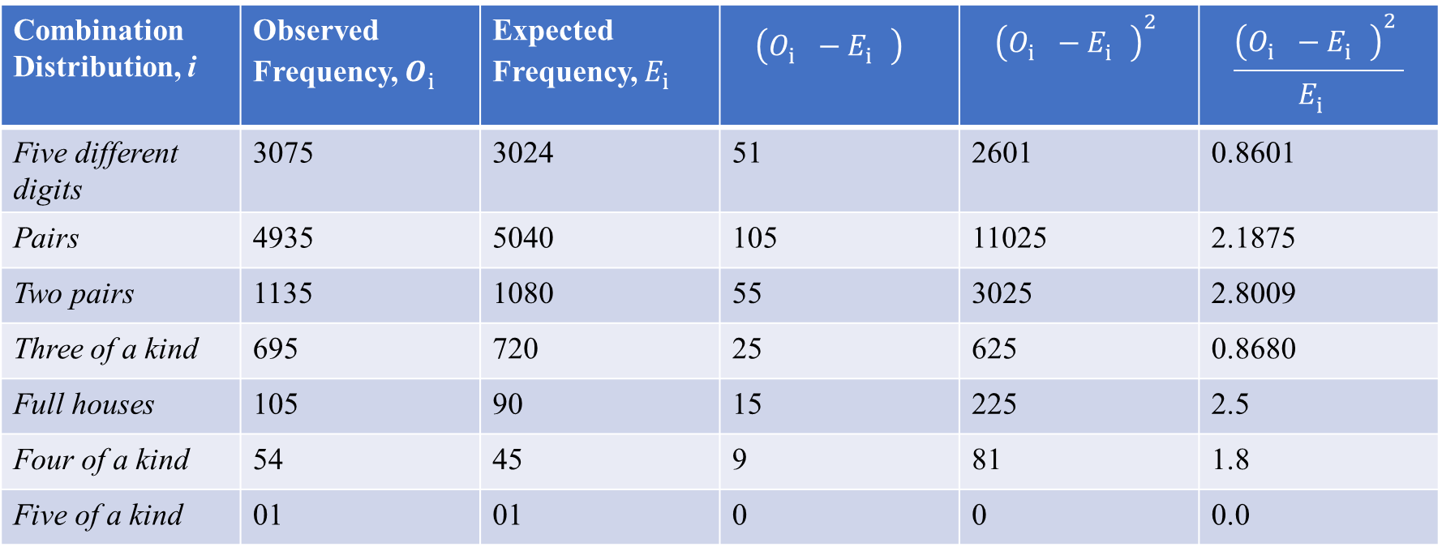
RANDOM NUMBERS
ANSWER
Combination Distribution, i | Observed Frequency, $O_{i}^{}$ | Expected Frequency, $E_{i}^{}$ | $${\left(O_{i}^{}−E_{i}^{}\right)}_{}^{}$$ | $${\left(O_{i}^{}−E_{i}^{}\right)}_{}^{2}$$ | $$\frac{{\left(O_{i}^{}−E_{i}^{}\right)}_{}^{2}}{E_{i}^{}}$$
Five different digits | 3075 | 3024 | 51 | 2601 | 0.8601
Pairs | 4935 | 5040 | 105 | 11025 | 2.1875
Two pairs | 1135 | 1080 | 55 | 3025 | 2.8009
Three of a kind | 695 | 720 | 25 | 625 | 0.8680
Full houses | 105 | 90 | 15 | 225 | 2.5
Four of a kind | 54 | 45 | 9 | 81 | 1.8
Five of a kind | 01 | 01 | 0 | 0 | 0.0
Total = 10,000 10,000 11.0165

Slide 5
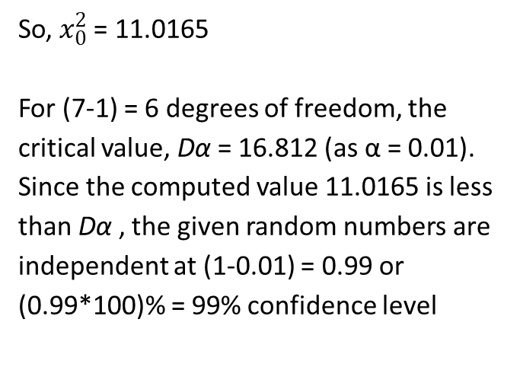
RANDOM NUMBERS
So, $x_{0}^{2}$= 11.0165
For (7-1) = 6 degrees of freedom, the critical value, Dα = 16.812 (as α = 0.01). Since the computed value 11.0165 is less than Dα , the given random numbers are independent at (1-0.01) = 0.99 or (0.99*100)% = 99% confidence level
Chi-Square Critical values
Degrees of freedom | α = 0.05 | α = 0.02 | α = 0.01
1 | 3.841 | 5.412 | 6.635
2 | 5.991 | 7.824 | 9.210
3 | 7.815 | 9.837 | 11.345
4 | 9.448 | 11.668 | 13.277
5 | 11.070 | 13.388 | 15.087
6 | 12.592 | 15.033 | 16.812
7 | 14.067 | 16.622 | 18.475
8 | 15.507 | 18.168 | 20.090
9 | 16.919 | 19.679 | 21.666
10 | 18.307 | 21.161 | 23.209

